Slide 1
Object Detection: Deep Learning Approaches
Ufuk Can Biçici

Slide 2
Contents
What is Deep Learning?
Why Deep Learning Now?
Use Cases
Some Basics on Neural Networks: Backpropagation, SGD, Nonlinearities
Convolutional Neural Networks: Convolution, Pooling, Strides, Padding, Important Architectures
Object Detection: Problem definition, Before Deep Learning, After Deep Learning, Important DL Approaches
Conclusion

Slide 3
What is Deep Learning?
Like old neural networks, only with more layers.
Non-linear, hierarchical, abstract representations of data.
Flexible models with different output types and sizes.
Differentiable programming.

Slide 4
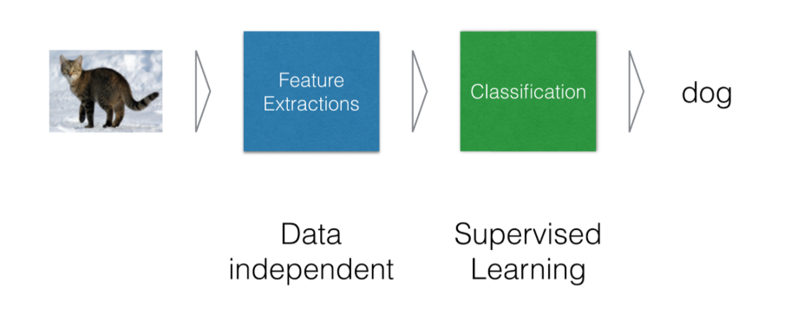
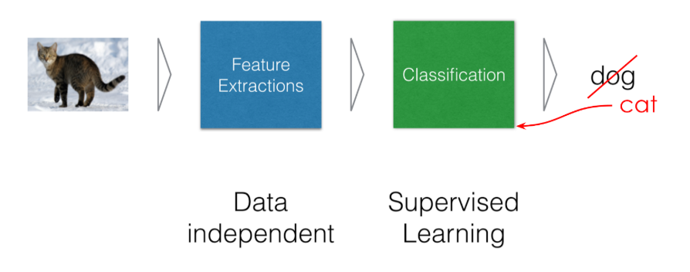
What is Deep Learning?
Old ML Pipelines:
Have to engineer features which entails the most informative data representation.
Apply classifier on these representations.
Most research – engineering efforts spent on Feature Extraction.
Numerical optimization only at the classification layer. Representations are fixed.

Slide 5
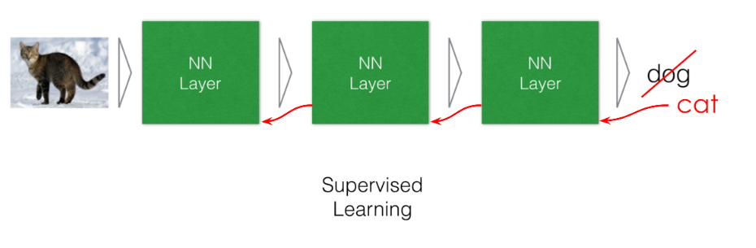
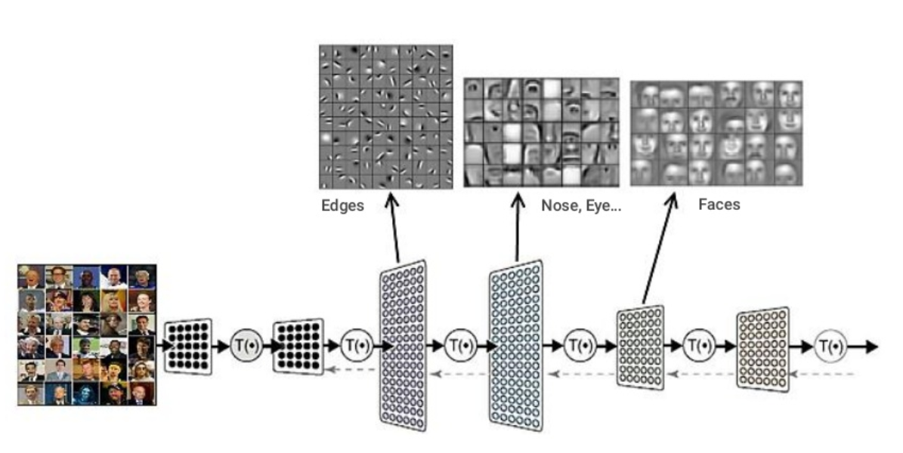
What is Deep Learning?
Deep Learning is heavily about learning representations from data.
If the representation for a sample is not optimal, it can be corrected with error signals from the loss function.
No fixed-recipe features; extracting features are a part of the optimization problem.
Learn hierarchical abstractions for the data.

Slide 6
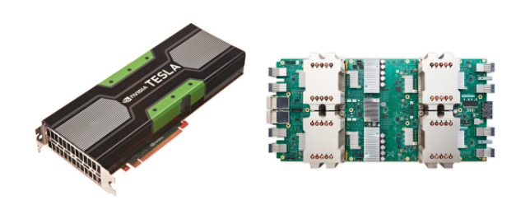
Why Deep Learning Now?
«Deep Learning», especially Convolutional Neural Networks are around since 1998 (Lecun – LeNet).
But we have now more computing power: GPUs, TPUs.

Slide 7
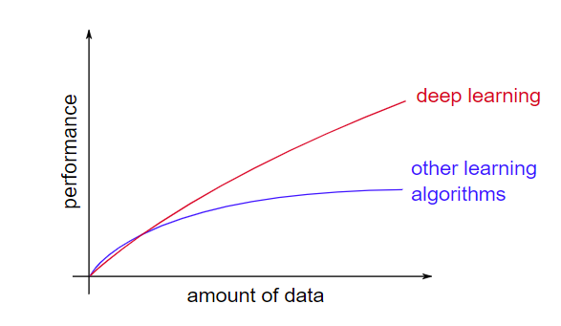
Why Deep Learning Now?
«Deep Learning», especially Convolutional Neural Networks are around since 1998 (Lecun – LeNet).
But we have now more computing power: GPUs, TPUs.
We have much larger labeled datasets and Transfer Learning works well. (ImageNet).
Deep Learning are heavily parametrized and scale well with large datasets.

Slide 8
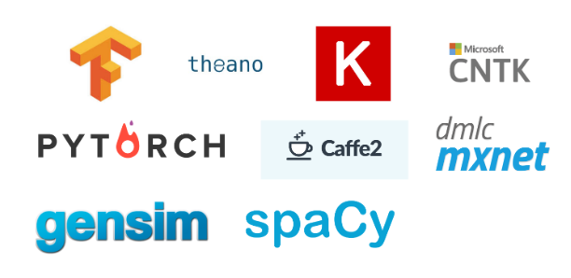
Why Deep Learning Now?
«Deep Learning», especially Convolutional Neural Networks are around since 1998 (Lecun – LeNet).
But we have now more computing power: GPUs, TPUs.
We have much larger labeled datasets and Transfer Learning works well. (ImageNet).
Deep Learning are heavily parametrized and scale well with large datasets.
A lot of deep learning frameworks emergerd; supporting GPU-TPU.

Slide 9
Why Deep Learning Now?
«Deep Learning», especially Convolutional Neural Networks are around since 1998 (Lecun – LeNet).
But we have now more computing power: GPUs, TPUs.
We have much larger labeled datasets and Transfer Learning works well. (ImageNet).
Deep Learning are heavily parametrized and scale well with large datasets.
A lot of deep learning frameworks emergerd; supporting GPU-TPU.

Slide 10
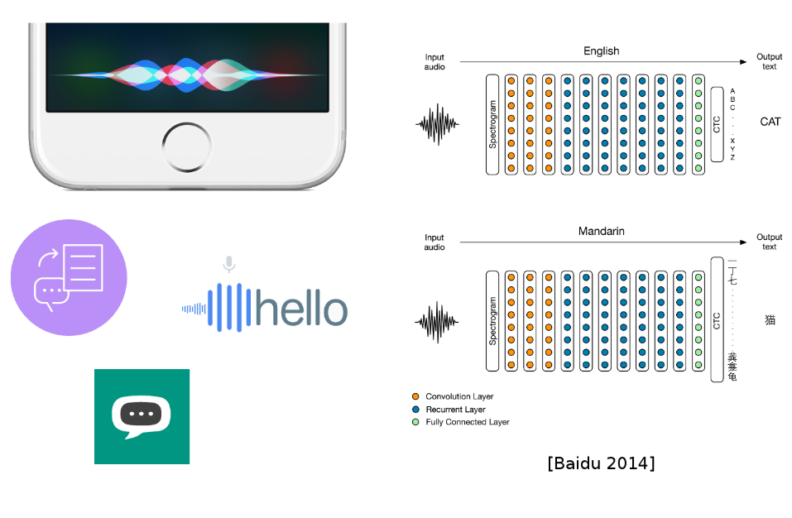
Use Cases: Speech to Text

Slide 11
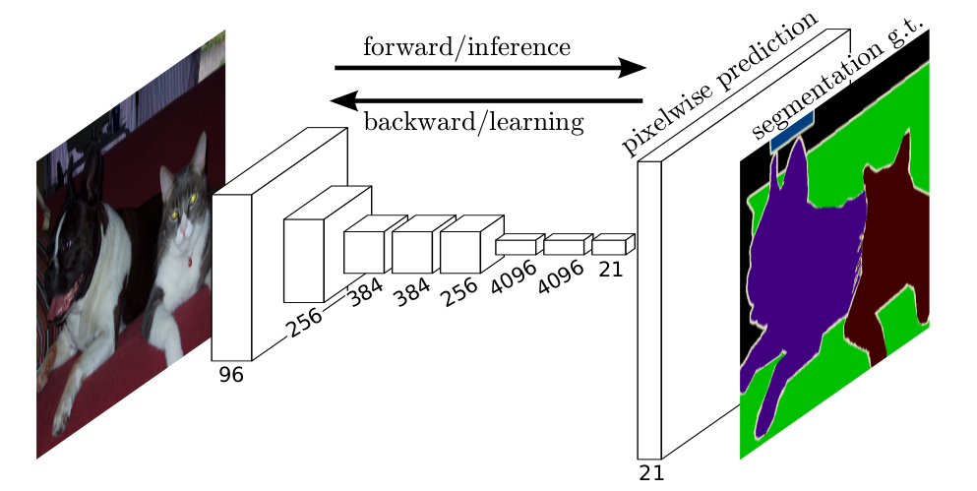
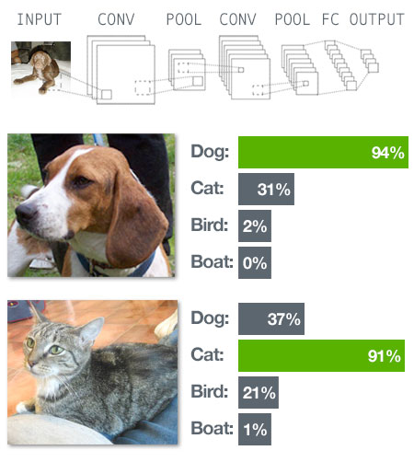
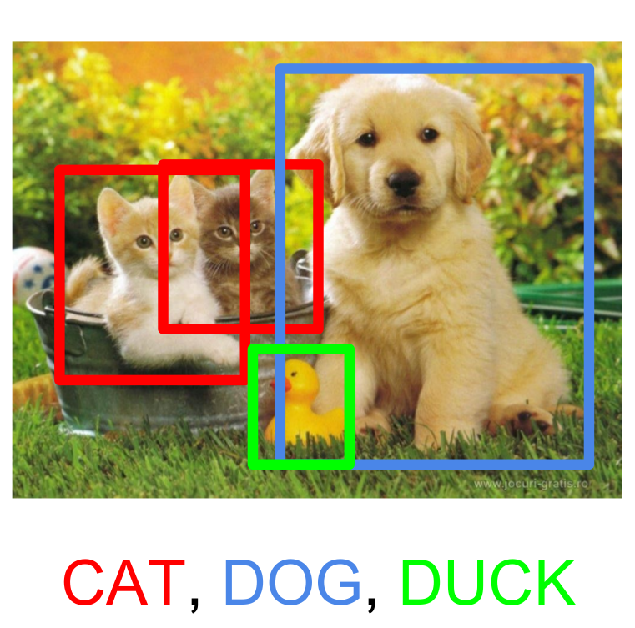
Use Cases: Vision
Image Segmentation
Image Classification
Object Detection

Slide 12
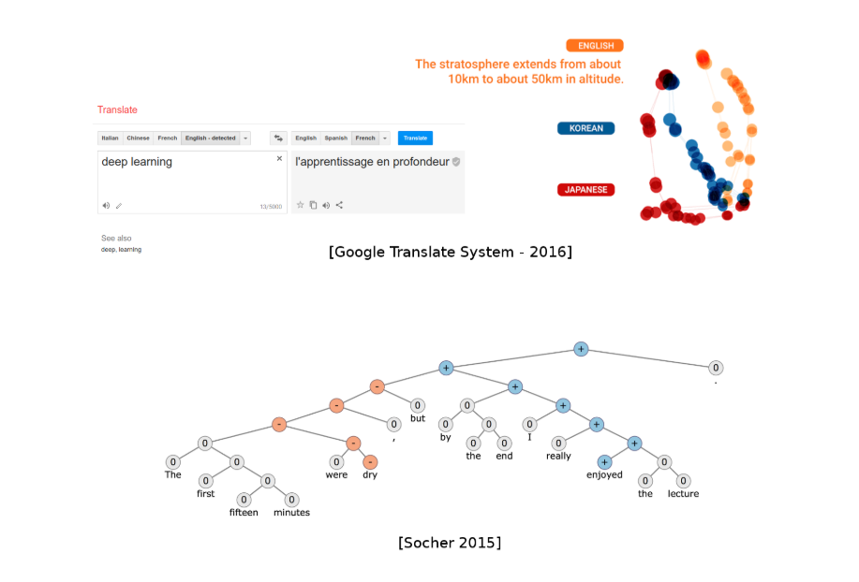
Use Cases: NLP

Slide 13
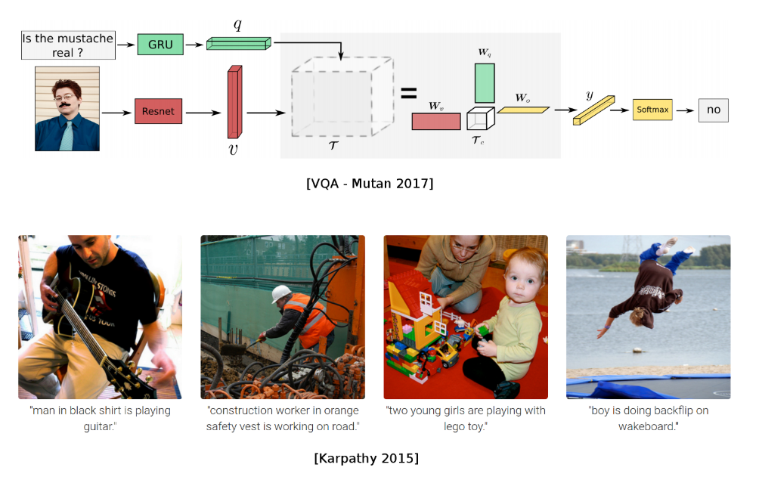
Use Cases: Vision + NLP

Slide 14
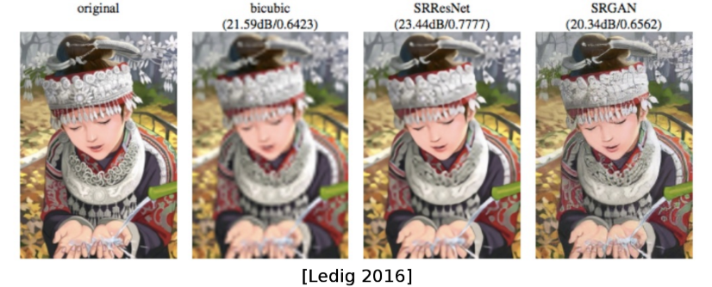
Use Cases: Super Resolution – Image Restoration

Slide 15
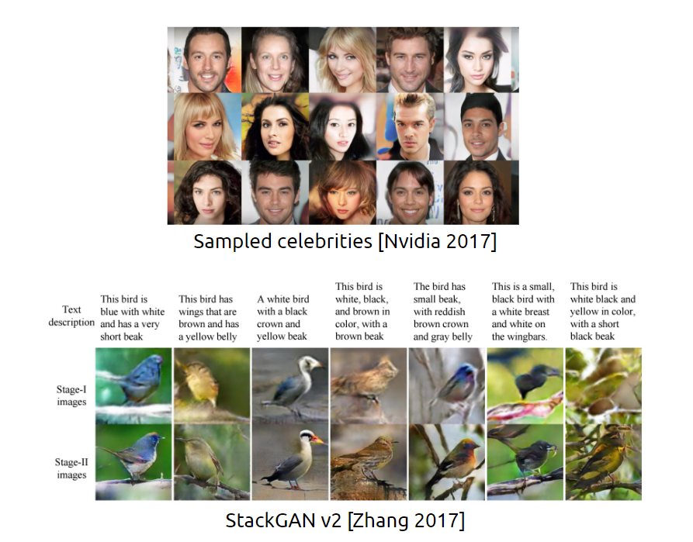
Use Cases: Generative Models

Slide 16
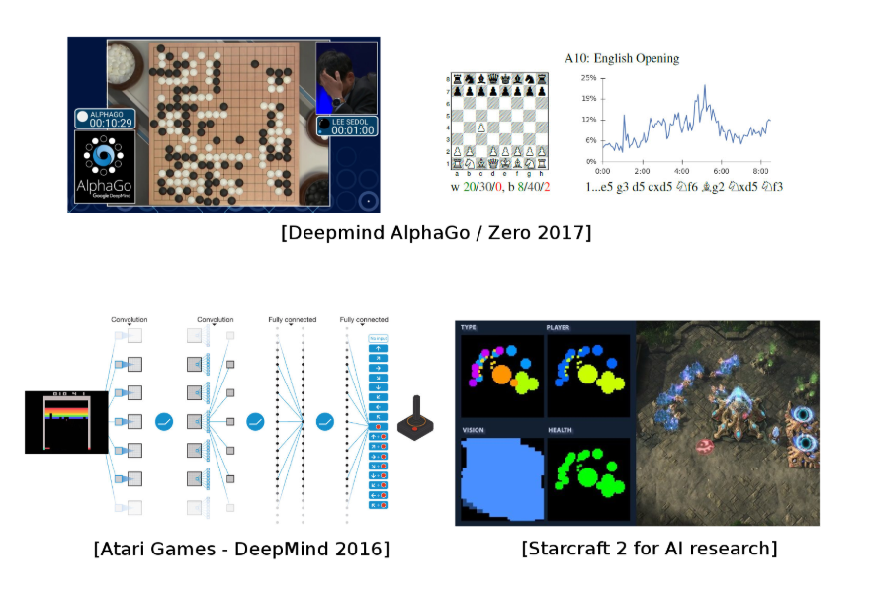
Use Cases: Reinforcement Learning

Slide 17
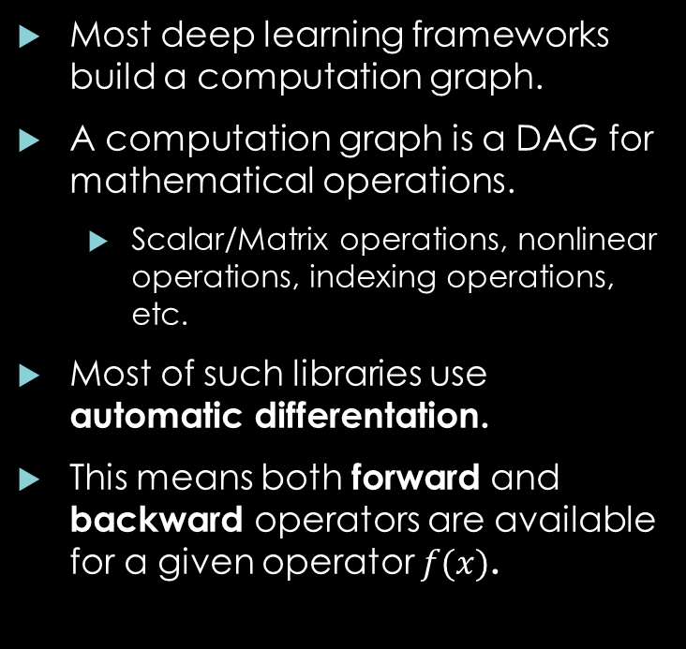
On Deep Learning Frameworks
Most deep learning frameworks build a computation graph.
A computation graph is a DAG for mathematical operations.
Scalar/Matrix operations, nonlinear operations, indexing operations, etc.
Most of such libraries use automatic differentation.
This means both forward and backward operators are available for a given operator $f(x)$.

Slide 18
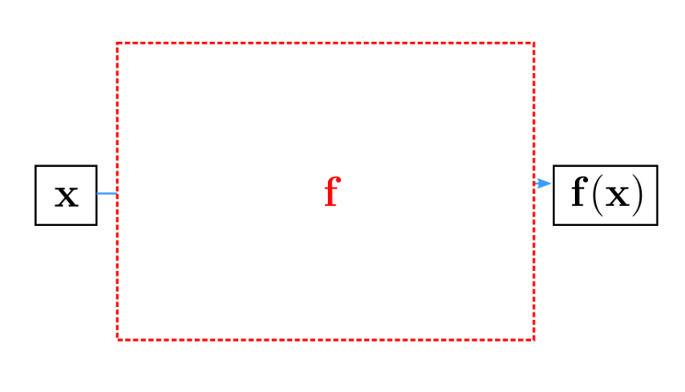
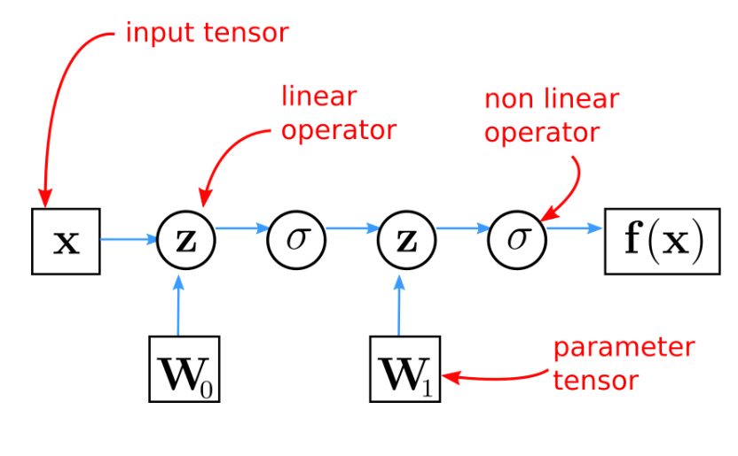
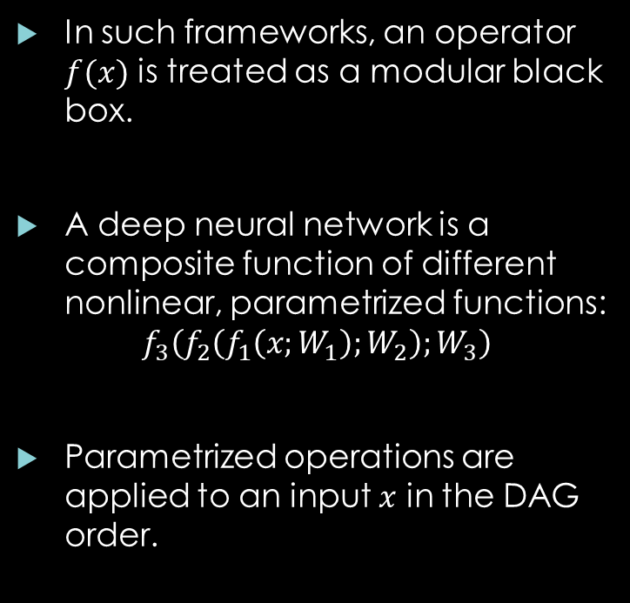
On Deep Learning Frameworks
In such frameworks, an operator $f(x)$ is treated as a modular black box.
A deep neural network is a composite function of different nonlinear, parametrized functions:
$$f_{3}\left(f_{2}\left(f_{1}\left(x;W_{1}\right);W_{2}\right);W_{3}\right)$$
Parametrized operations are applied to an input $x$ in the DAG order.

Slide 19
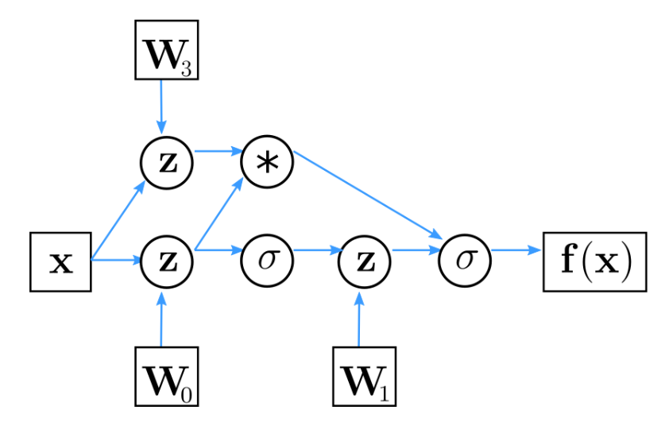
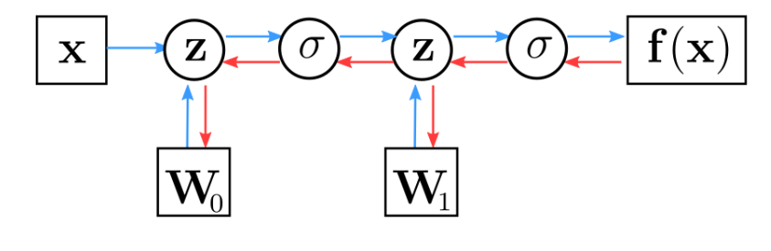
On Deep Learning Frameworks
An important note: These operations do not need to be in a sequential order.
Operations are differetiable as well.
Not every operation: Like sampling from a distribution. These are topics of research.
Fundamental Logic: Design each operation as a module, with a forward and backward (differentiaton) calculation.

Slide 20
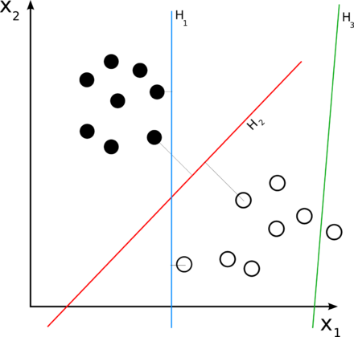
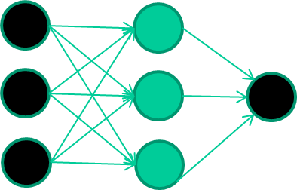
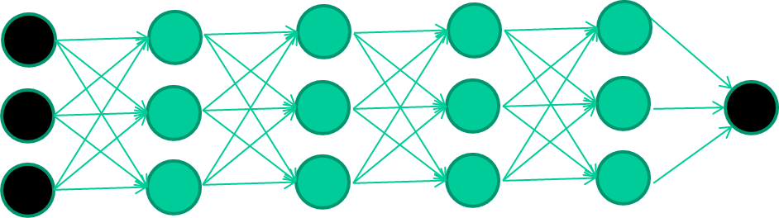
Nonlinearities
In the core of deep learning lies learning representations.
They are about applying nonlinearities to an input.
Warp the input such that it becomes linearly separable in a feature space.
Multiple layers with nonlinearities: More powerful representations.

Slide 21
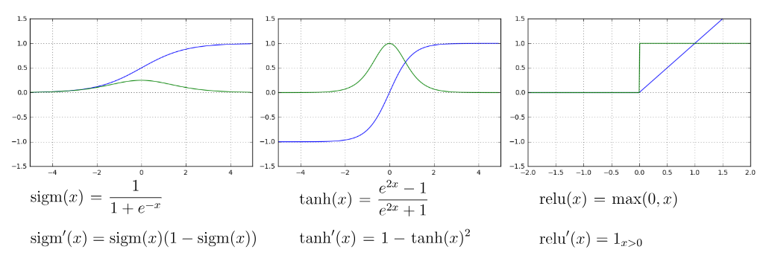
Some Popular Nonlinearities

Slide 22
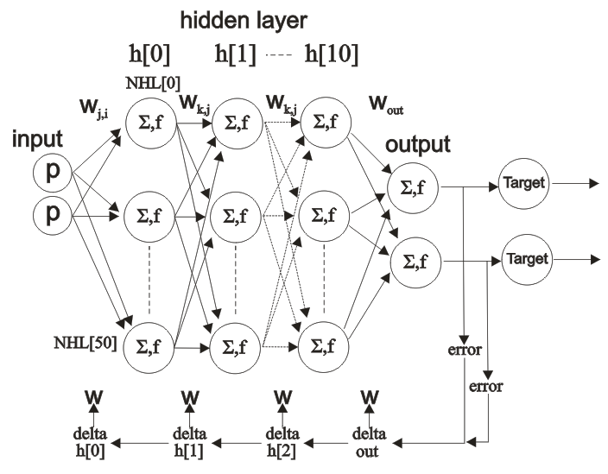
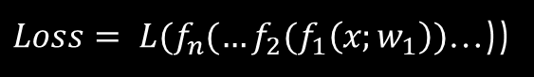

Backpropogation
Forward Propagation
$Loss= {L({f_{n}(…f}_{2}(f}_{1}\left(x;w_{1}\right))$…))
Backpropagation
$$\frac{∂Loss}{∂w_{1}}= \frac{∂L}{∂f_{n}}\frac{∂f_{n}}{∂f_{n−1}}…\frac{∂f_{2}}{∂f_{1}}\frac{∂f_{1}}{∂w_{1}}$$
In the last layer, we have a scalar error function.
For example: Cross entropy for classification, mean squared error for regression.
This error function measures how distant we are from a perfect fitness on the training set.
All parameters (weight matrices, filters, biases) are updated by negative gradients produced by the loss function. (Basic gradient descent).
The chain rule of calculus enables us to calculate each partial derivate with dynamic programming.

Slide 23
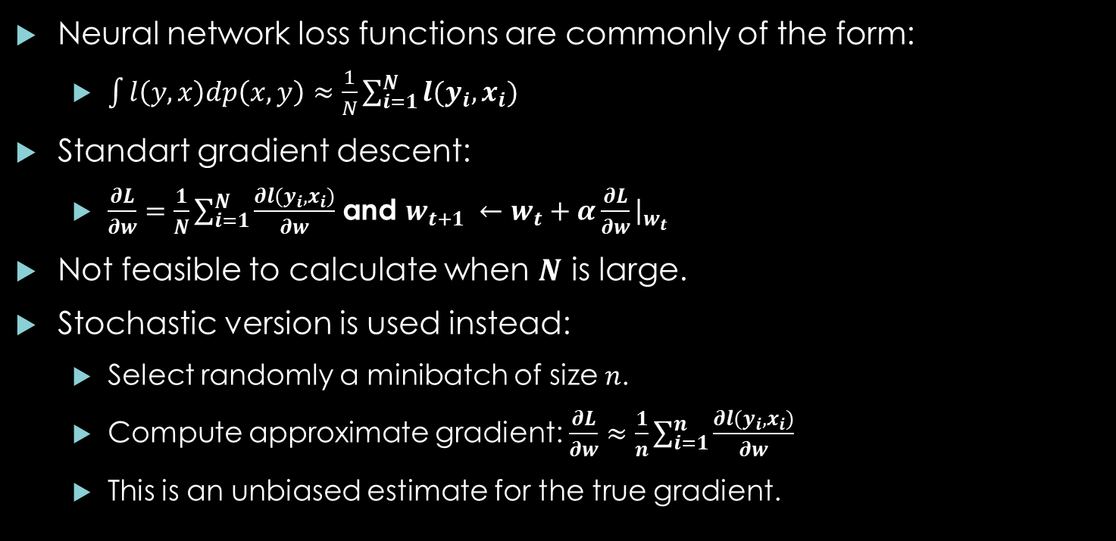
Stochastic Gradient Descent
Neural network loss functions are commonly of the form:
$\int{l\left(y,x\right)dp\left(x,y\right)}≈\frac{1}{N}\sum_{i=1}^{N}{l(y_{i},x_{i})}$
Standart gradient descent:
$\frac{∂L}{∂w}=\frac{1}{N}\sum_{i=1}^{N}{\frac{∂l(y_{i},x_{i})}{∂w}}$ and $w_{t+1} ←w_{t}+α\frac{∂L}{∂w}{\left.​\right|}_{w_{t}}$
Not feasible to calculate when $N$ is large.
Stochastic version is used instead:
Select randomly a minibatch of size $n$.
Compute approximate gradient: $\frac{∂L}{∂w}≈\frac{1}{n}\sum_{i=1}^{n}{\frac{∂l(y_{i},x_{i})}{∂w}}$
This is an unbiased estimate for the true gradient.

Slide 24
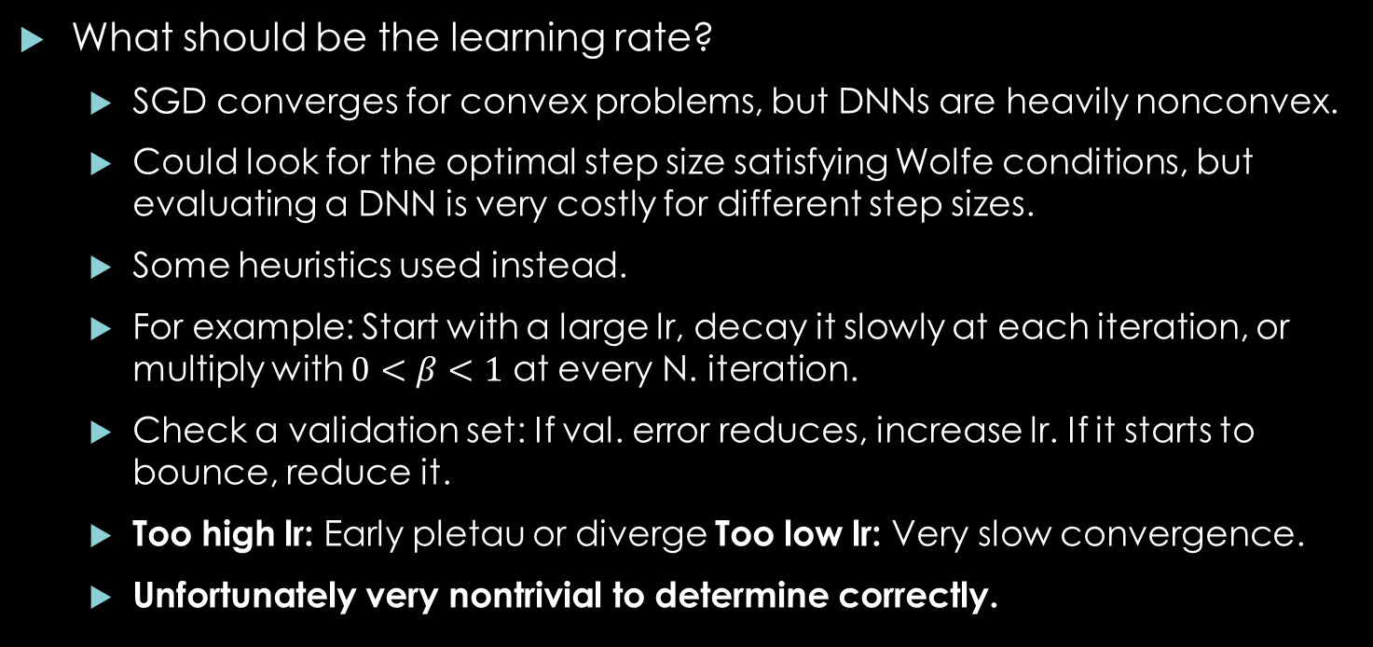
Issues With SGD
What should be the learning rate?
SGD converges for convex problems, but DNNs are heavily nonconvex.
Could look for the optimal step size satisfying Wolfe conditions, but evaluating a DNN is very costly for different step sizes.
Some heuristics used instead.
For example: Start with a large lr, decay it slowly at each iteration, or multiply with $0<β<1$ at every N. iteration.
Check a validation set: If val. error reduces, increase lr. If it starts to bounce, reduce it.
Too high lr: Early pletau or diverge Too low lr: Very slow convergence.
Unfortunately very nontrivial to determine correctly.

Slide 25
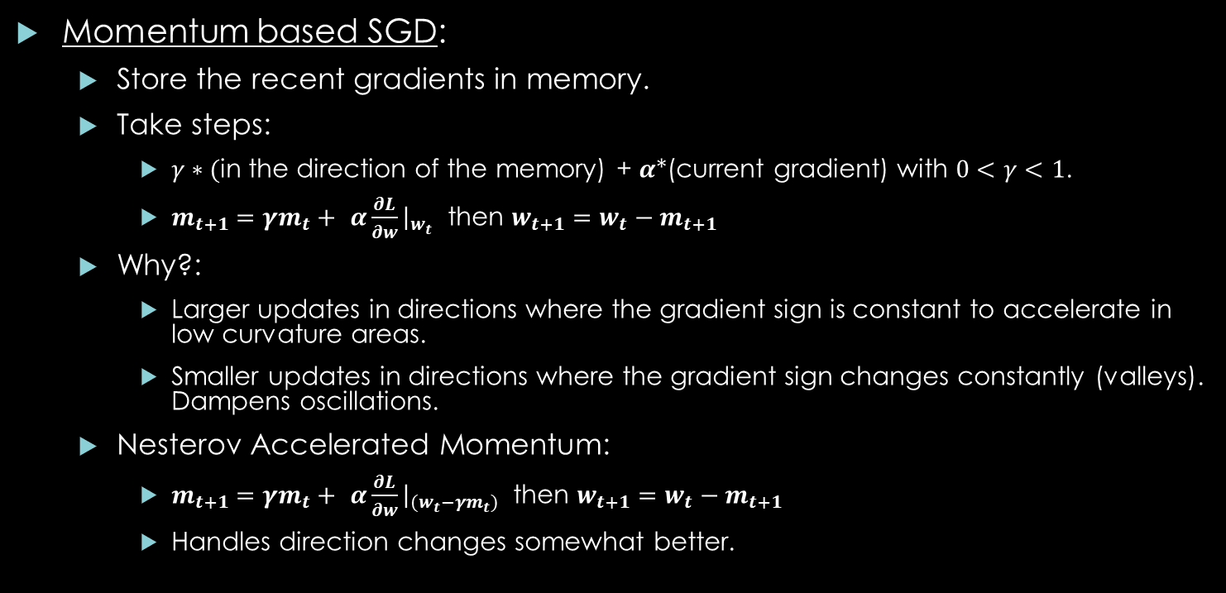
Issues With SGD
Momentum based SGD:
Store the recent gradients in memory.
Take steps:
$γ∗($in the direction of the memory) + $α$*(current gradient) with $0<γ<1$.
$m_{t+1}=γm_{t}+$ $α\frac{∂L}{∂w}{\left.​\right|}_{w_{t}}$ then $w_{t+1}=w_{t}−m_{t+1}$
Why?:
Larger updates in directions where the gradient sign is constant to accelerate in low curvature areas.
Smaller updates in directions where the gradient sign changes constantly (valleys). Dampens oscillations.
Nesterov Accelerated Momentum:
$m_{t+1}=γm_{t}+$ $α\frac{∂L}{∂w}{\left.​\right|}_{{(w}_{t}−γm_{t})}$ then $w_{t+1}=w_{t}−m_{t+1}$
Handles direction changes somewhat better.

Slide 26
Issues With SGD
Momentum based SGD:
Store the recent gradients in memory.
Take steps:
$γ∗($in the direction of the memory) + $α$*(current gradient) with $0<γ<1$.
$m_{t+1}=γm_{t}+$ $α\frac{∂L}{∂w}{\left.​\right|}_{w_{t}}$ then $w_{t+1}=w_{t}−m_{t+1}$
Why?:
Larger updates in directions where the gradient sign is constant to accelerate in low curvature areas.
Smaller updates in directions where the gradient sign changes constantly (valleys). Dampens oscillations.
Nesterov Accelerated Momentum:
$m_{t+1}=γm_{t}+$ $α\frac{∂L}{∂w}{\left.​\right|}_{{(w}_{t}−γm_{t})}$ then $w_{t+1}=w_{t}−m_{t+1}$
Handles direction changes somewhat better.

Slide 27
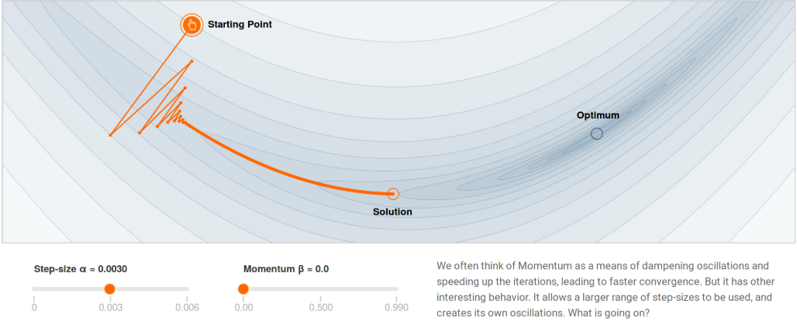
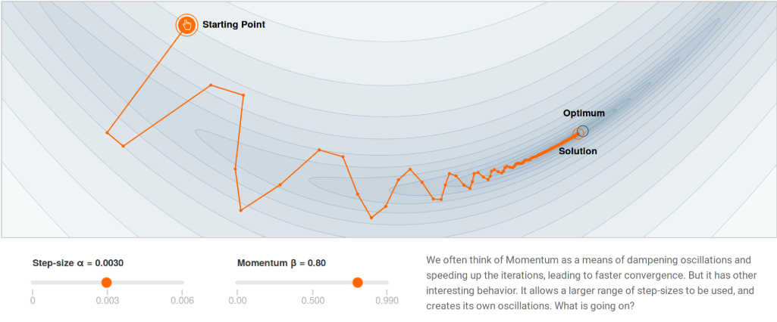
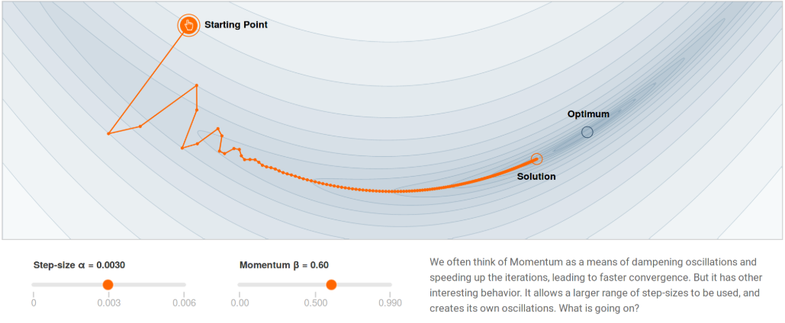
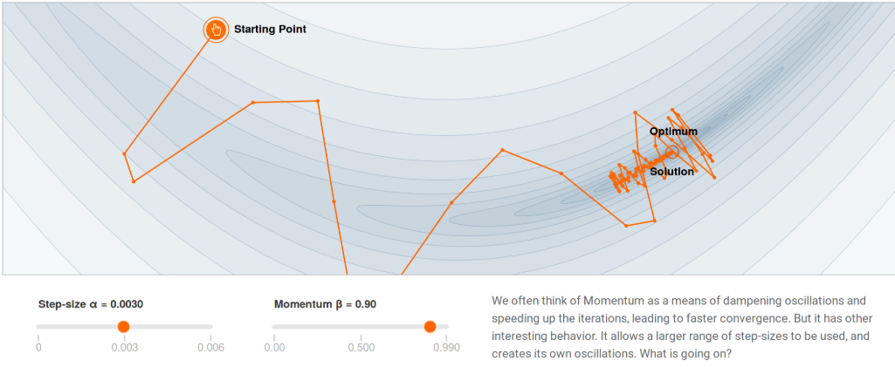
Effects of Momentum

Slide 28
Automatic Scaling of the Learning Rate
Setting a suitable learning rate schedule is EXTREMELY difficult.
A lot of cross-validation steps, babysitting the training process for hours, for days, even for weeks etc...
Need a way to automatically fine tune the learning rate, as the training progresses.
RPROP,RMSPROP: These methods change the learning rate using the sign history of the partial derivatives.
If too many sign flips: Slow down. If the sign is constant: Accelerate.
Adagrad, Adam: These methods use first and second order statistics (mean, std) of the partial derivatives to fine tune the learning rate.
!!!This is a very hot research area!!!

Slide 29
Automatic Scaling of the Learning Rate
Setting a suitable learning rate schedule is EXTREMELY difficult.
A lot of cross-validation steps, babysitting the training process for hours, for days, even for weeks etc...
Need a way to automatically fine tune the learning rate, as the training progresses.
RPROP,RMSPROP: These methods change the learning rate using the sign history of the partial derivatives.
If too many sign flips: Slow down. If the sign is constant: Accelerate.
Adagrad, Adam: These methods use first and second order statistics (mean, std) of the partial derivatives to fine tune the learning rate.
!!!This is a very hot research area!!!

Slide 30
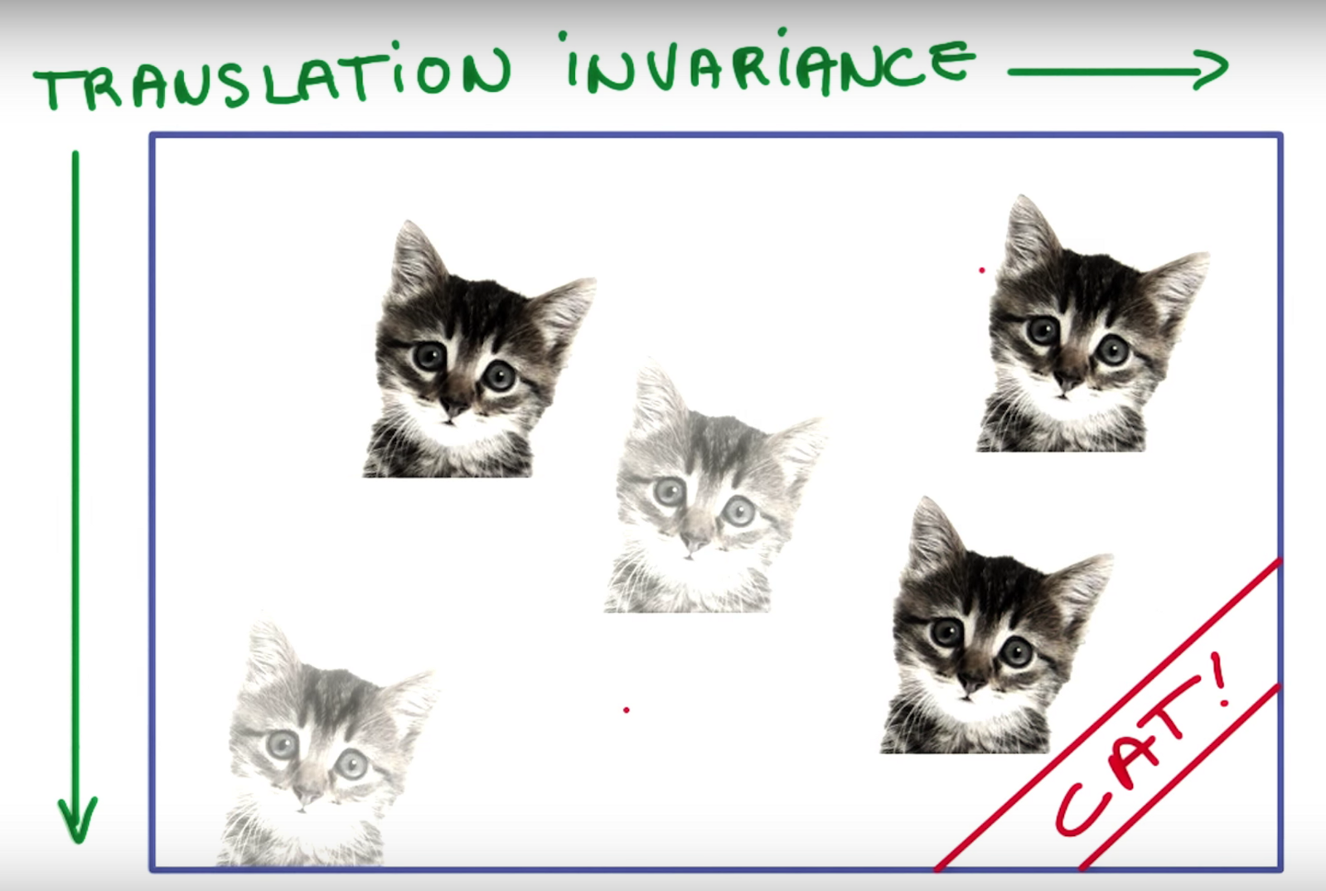
Convolutional Neural Networks
Fully connected layers destroy all spatial information when processing image.
Take an input image, translate a few pixels randomly. A MLP will most likely misclassify it.
Why?
Convolutional Neural Networks are translation invariant.
Use a sliding window on the input image.
High activations will occur for a specific template, regardless of its position.

Slide 31
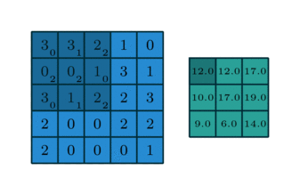
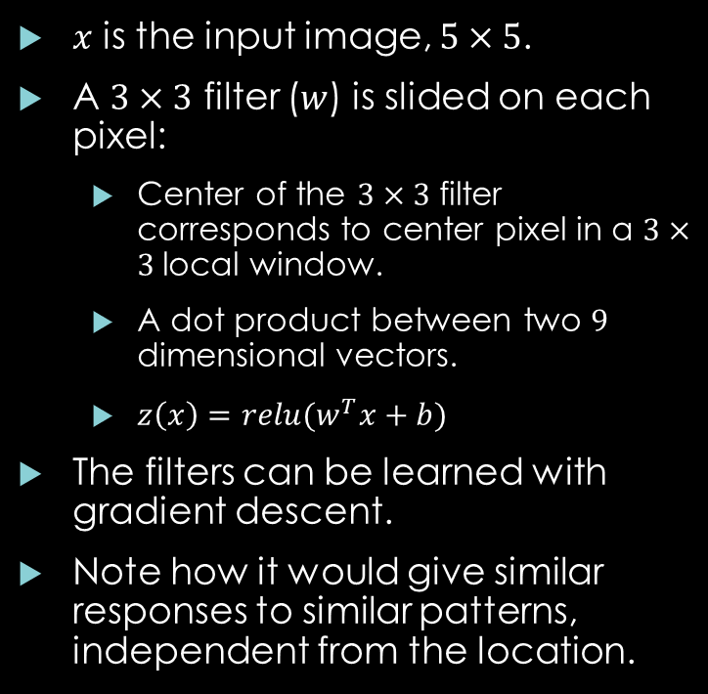
Convolutional Neural Networks
$x$ is the input image, $5×5$.
A $3×3$ filter ($w$) is slided on each pixel:
Center of the $3×3$ filter corresponds to center pixel in a $3×3$local window.
A dot product between two $9$ dimensional vectors.
$z\left(x\right)=relu(w^{T}x+b)$
The filters can be learned with gradient descent.
Note how it would give similar responses to similar patterns, independent from the location.

Slide 32
Convolutional Neural Networks
Main Motivations:
Local Connectivity: Translation invariance. Each output pixel depends on a small input window.
Parameter Sharing: Reduce overfitting and memory footprint.
Make use of the spatial relationships: Pixels close to each other are highly correlated. We can learn this correlation.

Slide 33
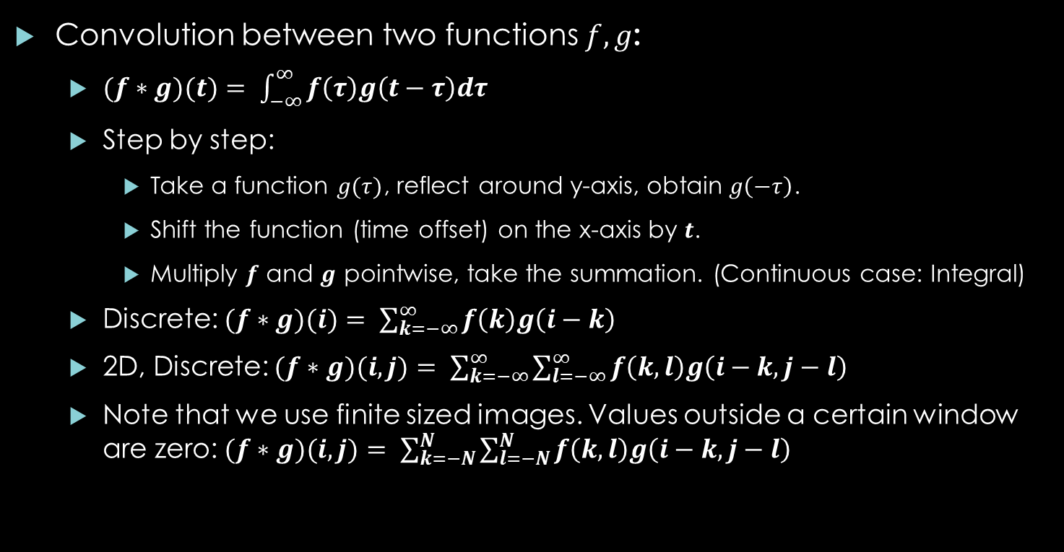
Convolutional Neural Networks
Convolution between two functions $f,g$:
$(f∗g)(t)= \int_{−∞}^{∞}{f\left(τ\right)g\left(t−τ\right)dτ}$
Step by step:
Take a function $g(τ)$, reflect around y-axis, obtain $g\left(−τ\right)$.
Shift the function (time offset) on the x-axis by $t$.
Multiply $f$ and $g$ pointwise, take the summation. (Continuous case: Integral)
Discrete: $(f∗g)(i)= \sum_{k=−∞}^{∞}{f\left(k\right)g\left(i−k\right)}$
2D, Discrete: $(f∗g)(i,j)= \sum_{k=−∞}^{∞}{\sum_{l=−∞}^{∞}{f\left(k,l\right)g\left(i−k,j−l\right)}}$
Note that we use finite sized images. Values outside a certain window are zero: $(f∗g)(i,j)= \sum_{k=−N}^{N}{\sum_{l=−N}^{N}{f\left(k,l\right)g\left(i−k,j−l\right)}}$

Slide 34
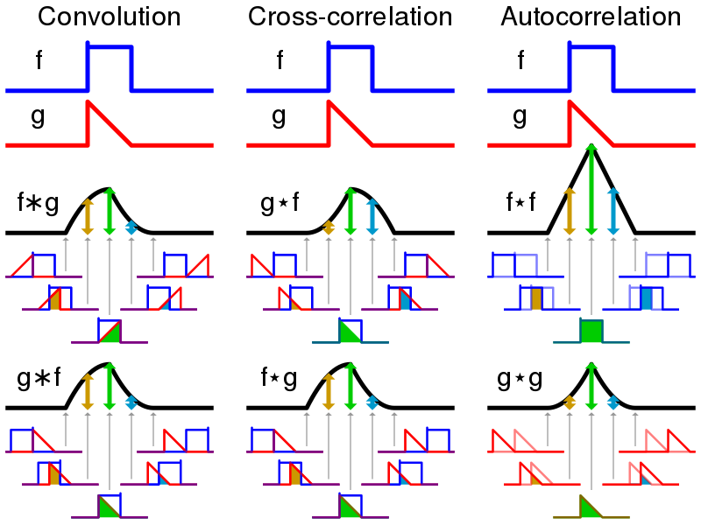
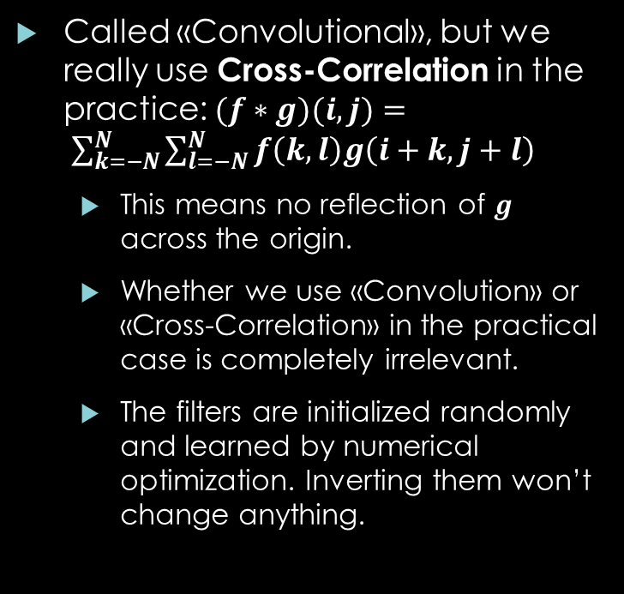
Convolutional Neural Networks
Called «Convolutional», but we really use Cross-Correlation in the practice: $(f∗g)(i,j)= \sum_{k=−N}^{N}{\sum_{l=−N}^{N}{f\left(k,l\right)g\left(i+k,j+l\right)}}$
This means no reflection of $g$ across the origin.
Whether we use «Convolution» or «Cross-Correlation» in the practical case is completely irrelevant.
The filters are initialized randomly and learned by numerical optimization. Inverting them won’t change anything.

Slide 35
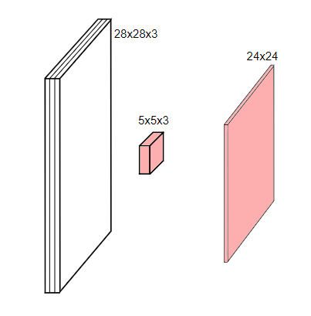
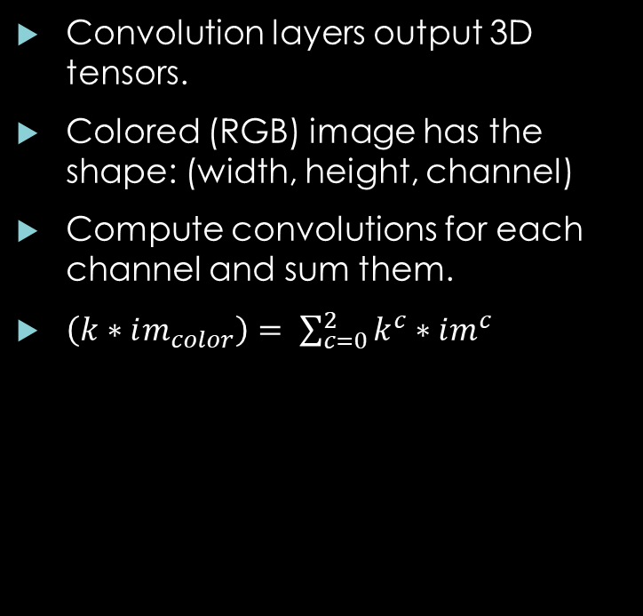
Channels or «Depth» Component
Convolution layers output 3D tensors.
Colored (RGB) image has the shape: (width, height, channel)
Compute convolutions for each channel and sum them.
$\left(k∗im_{color}\right)= \sum_{c=0}^{2}{k^{c}∗im^{c}}$

Slide 36
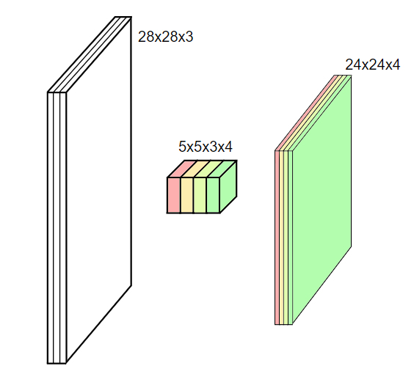
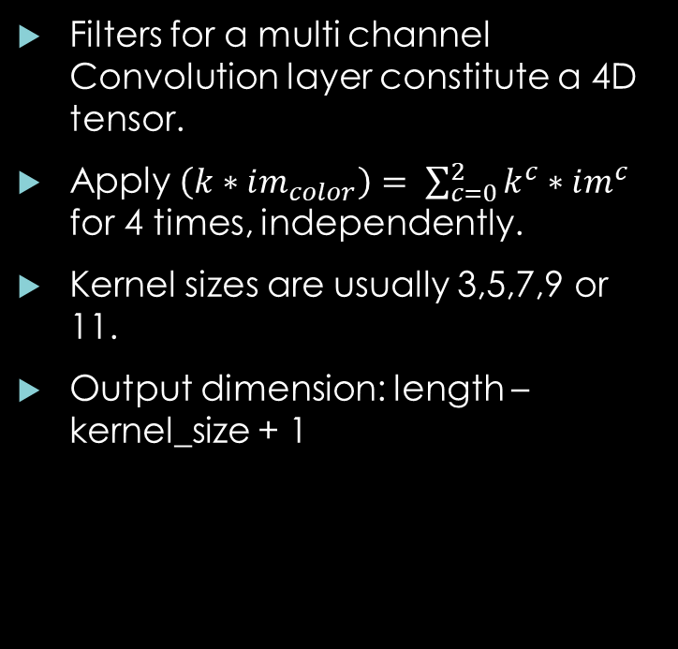
Channels or «Depth» Component
Filters for a multi channel Convolution layer constitute a 4D tensor.
Apply $\left(k∗im_{color}\right)= \sum_{c=0}^{2}{k^{c}∗im^{c}}$ for 4 times, independently.
Kernel sizes are usually 3,5,7,9 or 11.
Output dimension: length – kernel_size + 1

Slide 37

Strides
Stride: Incremental step size for the convolutional filter.
Used for reducing the size of the output feature map.

Slide 38

Padding
Up to now, we assumed that the filter’s center correspond to such pixels of the input, that the filter doesn’t have to operate outside of the image.
We can artificially fill zeros around the original image as a workaround.
When stride=1, this creates output with the same size as the input.
Sometimes called «SAME» padding. («VALID» padding is the other way around).

Slide 39
Padding
Up to now, we assumed that the filter’s center correspond to such pixels of the input, that the filter doesn’t have to operate outside of the image.
We can artificially fill zeros around the original image as a workaround.
When stride=1, this creates output with the same size as the input.
Sometimes called «SAME» padding. («VALID» padding is the other way around).

Slide 40
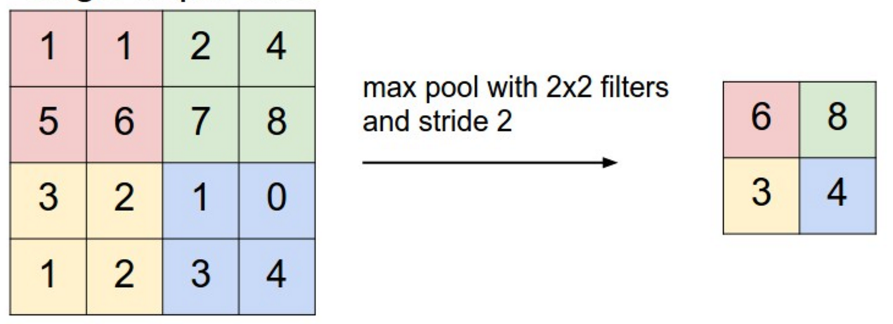
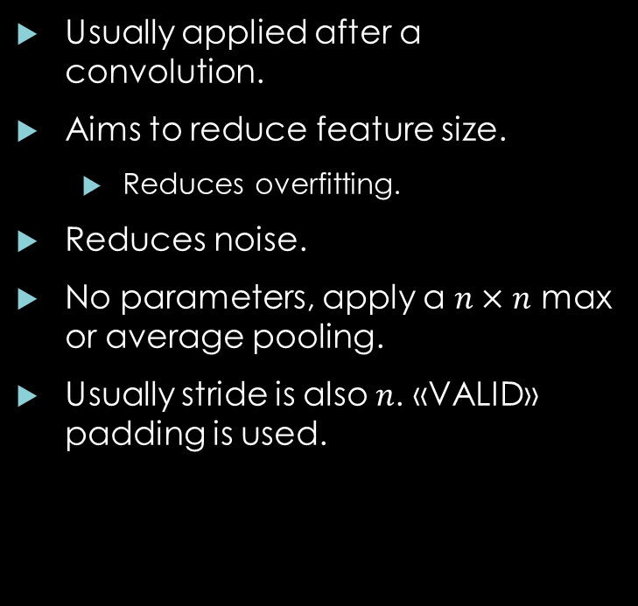
Pooling
Usually applied after a convolution.
Aims to reduce feature size.
Reduces overfitting.
Reduces noise.
No parameters, apply a $n×n$ max or average pooling.
Usually stride is also $n$. «VALID» padding is used.

Slide 41
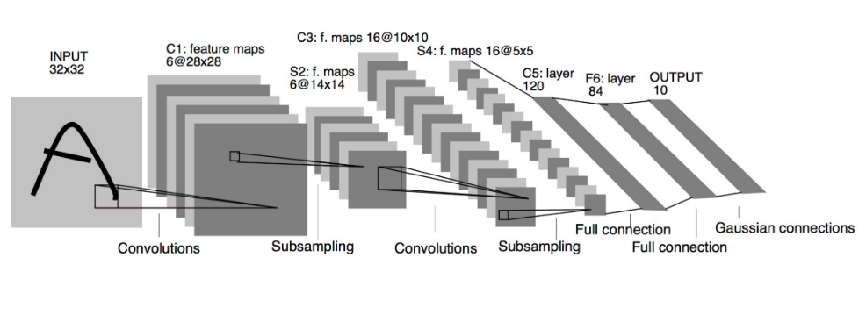
Some Important Architectures
LeNet (1998):
2 or 3 5x5 convolutional layers, followed by tanh (ReLU) nonlinearities.
Last 2 layers are fully connected.
20 years old but still used for many not-too-complex problems.

Slide 42
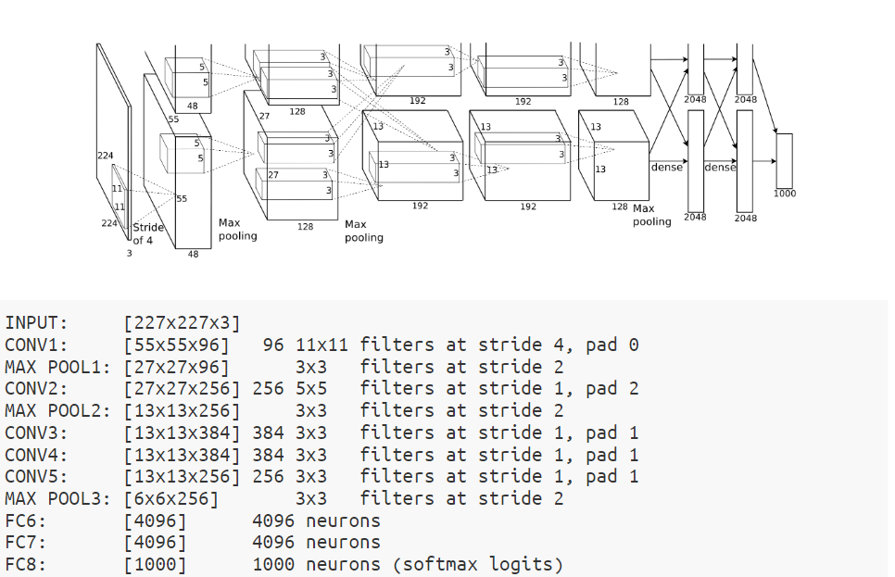
Some Important Architectures
AlexNet (2012):
A very large LeNet, actually.
Won the ImageNet challenge in 2012, first GPU implementation for training deep networks.
Regarded as the starter of the Deep Learning hype.
A very important regularizer is introduced: Dropout

Slide 43

Some Important Architectures
More On Dropout:
Usually applied to the last fully connected layers of the CNNs.
At each forward-backward pass, set some neurons artificially to 0, following a Bernoulli distribution with parameter, p.
Prevents FC layers to memorize the noise by depending only onto a single or few very highly activated neurons.
Simple but very powerful idea.
CNNs are notorious for their tendency to overfit...

Slide 44
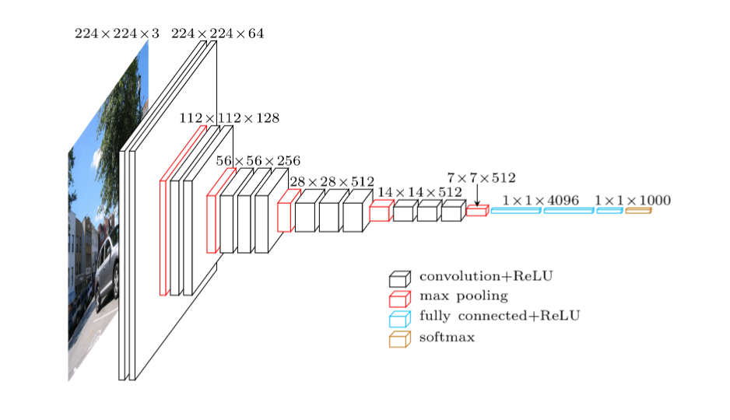
Some Important Architectures
VGG (2014):
Again, very highly parametrized LeNet type of networks.
Uses 3x3 convolution filters.

Slide 45


Some Important Architectures
ResNets (2016):
A very simple but powerful idea.
Let $F(x)$ be a convolutional layer + nonlinearity. (ReLU, max pool. Etc)
Represent this layer as: $F^{′}\left(x\right)=F\left(x\right)+x$
$x$ is just the identity connection; $F\left(x\right)$ is hypothesized to be learning the residual part, not the complete transformation.
Reduces vanishing gradient problems.
No FC layer in the end.
Allows training up to 1000+ layers!

Slide 46

Some Important Architectures
State-of-the-Art (2016-now):
Modular blocks
Bottleneck Layers
Inception Layers
DenseNets (Every layer takes as input every preceding layer. ResNet is a special case of that!)
Dynamic Architecture Learning:
Heuristic methods, Evolutionary algorithms, Reinforcement learning.

Slide 47

Object Detection Problem
Object detection is much more difficult compared to object classification:
Object o detect can be anywhere in the image (in different scales – distances)
There can be more than object in the image.
Some object can be occluded.
Some images may not contain any object at all.

Slide 48
Object Detection Problem
An object detection problem has to handle more multiple problems:
Finding areas with objects and localizing them.
False positive detections should be minimized and removed (Non Maximum Suppression)
Areas with actual objects should not be missed (False negative detections).
After localizing, area with the object must be classified correctly.

Slide 49
Object Detection Problem - Literature
Before Deep Learning
After Deep Learning
Sliding Window Detectors
Cascaded Object Detectors (Haar Features)
Deformable Parts Models
Region Proposal Methods
Feature Extraction For Detectors(HOG, SIFT, Color Histograms, Bag of Words-Fisher Vectors)
Convolutional Neural Networks(LeNet, AlexNet, VGG, ResNet, vb.)
Approaches using 3. party region proposals (R-CNN, Fast R-CNN)
Networks learning region proposals(RPN)
Two stage detectors (Faster R-CNN, R-FCN)
Single stage detectors (YOLO, SSD)

Slide 50
Sliding Window Detectors (CVPR 2005 – Dalal Triggs)
Sliding window methods treat the problem as multiple object classifications, embedded into a single image.
Look for every possible location and check if it is background or not. If foreground, which object?
CVPR-2005 Dalal – Triggs is the classical approach.
Originally intended for pedestrian detection, but can be extended. (For example OCR).
Build a image pyramid of different scales.
Extract HOG features at every sliding window location.
Train a linear SVM which classifies «Pedestrian or Not».
Hard Negative Mining: This is a heavily imbalanced problem (too many background, too few objects). Add false positive foreground detections incrementally into the dataset.
NMS (Non maximum Supression) reduces false positive detections.
Backbone for many similar algorithms.

Slide 51

Sliding Window Detectors (CVPR 2005 – Dalal Triggs)

Slide 52

Deformable Parts Model (TPAMI-2010 Felzenswalb et al.)
The object to be detected may be articulated, in the sense that it has different parts, moving in different patterns.
The idea is to build a model which incorporates the geometric relationships between these different parts.
“Deformable Parts Model”
Again HOG features are used, but the SVM is special: It includes geometric relationships.

Slide 53
Region Proposal Methods
Sliding window methods are expensive, if underlying feature extractors and/or classifiers are expensive: Exhaustive search.
A good alternative would be to obtain some «educated guesses» about the locations, where objects can potentially exist.
Such regions are generated by using simplistic color, texture, gradient magnitude features. Intiution: Objects of interest may create high frequency variations in such domains.
They are encouraged to generate many false positives of different scales at different locations. (Still will be much fewer than exhaustive search).
Some deep learning algorithms use these methods as a first step.

Slide 54

Region Proposal Methods (IJCV – 2012 Uijlings et al.)
“Selective Search” is one of the most common «region proposal» algorithms.
The image is segmented in the first step, by using any kind of segmentation algorithm, into many small regions.
Neighboring regions of similar color, texture and shape are merged. (Called superpixels).
The bounding box of every superpixel is then a potential object region.

Slide 55

Object Detection – Why Deep Learning?
We know that: Learning representations directly from the data is effective in classification.
Object detection is, in its core, a classification problem.
Why not use powerful representation learning approaches for it as well?
CNN features are more robust to translation, lighting and image noise compared to hand crafted features like SIFT, HOG.

Slide 56
Object Detection – Why Deep Learning?
In the last 4 years, CNN based object detectors have become the state-of-the-art.
The highest performance on datasets like PASCAL VOC and COCO are obtained with CNNs.
Roughly, there are two types of CNN object detectors:
Two step detectors(Decoupled localization and classification)
One step detectors(Localization and classification on the same pipeline.).

Slide 57

Object Detection with DL: R-CNN (CVPR – 2014, Girshick et al.)
R-CNN is one of the first DL approaches to object detection.
An AlexNet, trained on ImageNet, is used to extact features from region proposals.
Region proposals are generated with a 3. party algorithm (Selective Search).
Last layer of the AlexNet is used as a feature to a SVM.

Slide 58
Object Detection with DL: R-CNN (CVPR – 2014, Girshick et al.)
R-CNN has some major problems:
For each region proposal, a separate AlexNet is run: Insanely expensive!
A multi layered, complex training pipeline.
The AlexNet parameters are not updated during SVM training.

Slide 59

Object Detection with DL: SPP-Net, ECCV – 2014
Following works first got rid of a «Separate CNNs run for region» approach.
SPP-Net processes a single image, only once.
Original region proposals are projected onto the last convolutional layer.
Grids of different scales are applied to each region on the last feature map. This is called Region of Interest Pooling. The aim is to obtain a vector of fixed dimensionality.
Different grid scales are concatenated into a final feature vector.

Slide 60

Object Detection with DL: Fast R-CNN, ICCV – 2015
Different from SPP-Net, Fast R-CNN is trainable by backpropagation, end-to-end.
Includes a differentiable RoI Pooling layer.
On the last convolutional feature map, both bounding box regression and object classification are conducted.

Slide 61

Object Detection with DL: Faster R-CNN, NIPS – 2015
Using 3. party algorithms for object detection is a bottleneck.
Faster R-CNN is very important, in the sense that it proposes to replace the region proposal step with a completely differentiable neural operation.
The networks «learns» to make meaningful region proposal, by gradient descent.

Slide 62

Object Detection with DL: Faster R-CNN, NIPS – 2015
A sliding window, implemented with a CNN layer, operates on the last conv. Layer.
Each sliding window’s receptive field is calculated (backprojected into the input image).
Different «anchor boxes» of different size and scales are placed around the center of the receptive field.
Ground truth boxes are compared against these anchor boxes.

Slide 63
Object Detection with DL: Faster R-CNN, NIPS – 2015
IoU: Intersection over Union, the standart metric to measure the extent two bounding boxes overlap.
Anchor boxes and ground truths overlapping over a certain IoU threshold are «positive», under a certain threshold are «negative» detections (background).
Values in between are indeterminate; they are not used in the training.
A binary classifier for «object-background» discrimination and a bounding box regressor is trained.
Separately for k different anchor boxes.
All these can be implemented in convolutional layers.

Slide 64
Object Detection with DL: Faster R-CNN, NIPS – 2015
This is called «Region Proposal Network». The networks learns to generate object proposals.
RPN is connected to the end of a back bone CNN (like VGG19). A Fast R-CNN object detector is also connected to this backbone, using RPN outputs.
They are trained iteratively.
This is the backbone of many other DL object detectors and called two-stage detector.

Slide 65

Object Detection with DL: R-FCN, NIPS 2016
Faster R-CNN is the basis of many following two stage detectors.
R-FCN is one of them. It proposes an advanced object detector, dividing a proposal region into a 𝑘×𝑘 grid and learns different features for every part.
It learns the spatial relationship between different parts of an object. (Very roughly like the Deformable Part Model).

Slide 66

Object Detection with DL: Mask R-CNN, ICCV 2017
This work adds a pixel level classifier to the Faster R-CNN detector.
This modification enables instance level segmentation of the object.
Needs pixel level annotation. Instance based segmentation is a more complex problem than object detection.

Slide 67

Object Detection with DL: FPN, CVPR 2017
A very powerful method on the Faster R-CNN backbone.
The basic idea is to connect a RPN and Faster R-CNN detector to each image scale in the CNN and connecting these together. Different proposals and detectors belonging to different image scales are trained together.

Slide 68
Object Detection with DL: Single Step Detectors
All DL detectors up to this point, has two stages.
The first stage is to generate region proposals, either with a 3. party algorithm or a RPN detector.
The second stage involves object classifier and a bounding box regressor.
These two stages are trained iteratively. Main approach is to make RPN use Faster R-CNN’s convolutional layers and Faster R-CNN to use RPN’s region proposals for tuning the convolutional layers.

Slide 69
Object Detection with DL: Single Step Detectors
Different from those, there are approaches, which only use a single pipeline.
In such approaches, region proposers and object detectors are trained end-to-end, using a shared loss function.
Instead of a region proposal mechanism, they use a regular grid on the input image. The grid rectangles are used as predetermined anchors.
YOLO (You Only Look Once) and SSD are most well known single step detectors.

Slide 70
Object Detection with DL: Single Step Detectors
Single step (or single shot – single stage) detectors are fast in inference, but they perform relatively worse compared to two step ones.
Two main reasons:
Two step detectors learn optimal proposals with problem specific anchors. Single step ones use a predetermined regular grid.
According to «Focal Loss for Dense Object Detection», (Lin et al., 2017) paper, two step detectors are able to strike a good balance between positive and negative samples. Single step detectors produce a lot of negative samples, resulting in an imbalanced training problem.

Slide 71

Object Detection with DL: Single Step Detectors
YOLO bounding box proposals from regular grid

Slide 72

Object Detection with DL: Single Step Detectors
Two step and single step detectors; Accuracy vs Speed comparison

Slide 73

Object Detection with DL: Single Step Detectors
Single step detectors have difficulties in recognizing small objects. (Which is a hard problem for every type of detector)

Slide 74
The End
Questions?

